Slide 1
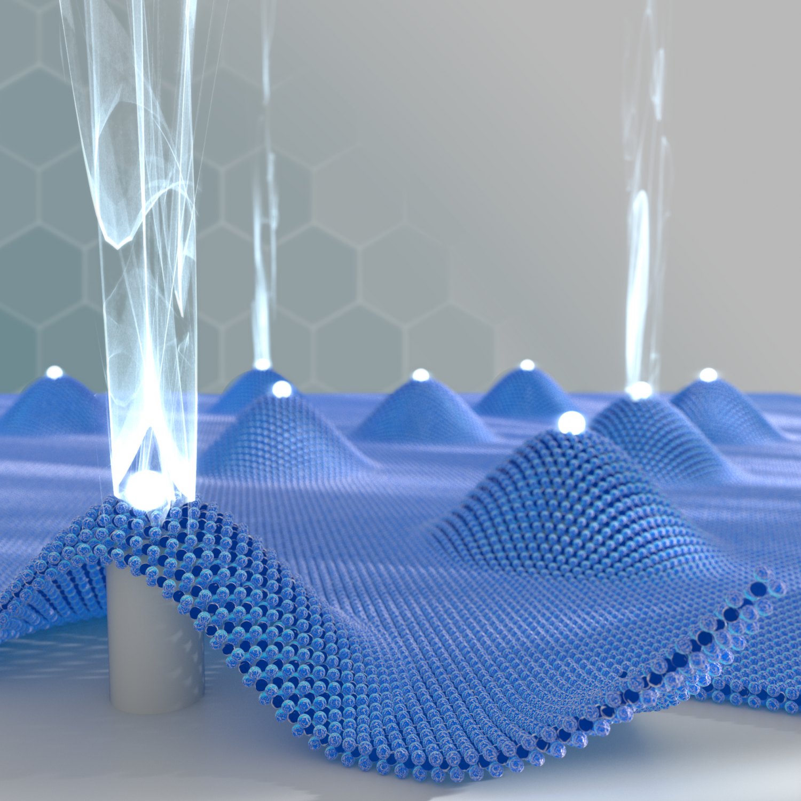
Quantum defects in 2D transition metal dichalcogenides for THz-technologies
Speaker: Jingda Zhang ^{1,2}
Jingda Zhang and Su Ying Quek*
12-Jun-24
¹Department of Physics, National University of Singapore, Singapore
²Centre for Advanced 2D Materials, National University of Singapore, Singapore
Notes:
https://phys.org/news/2017-05-creation-quantum-emitter-arrays.html

Slide 2
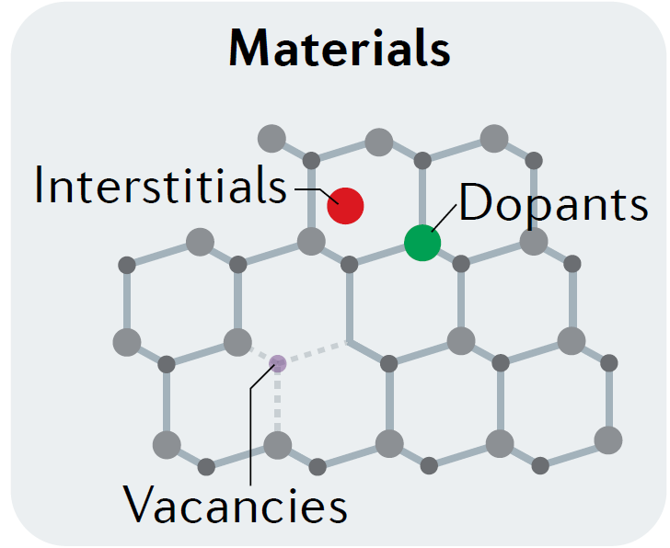
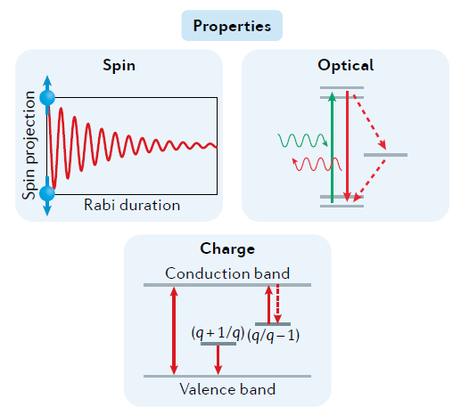
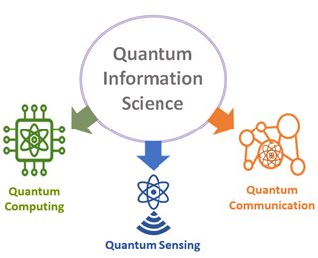
Spin defects
Isolated point defects:
Atomic-like systems defined by their spin, optical, charge, and their host material
Introducing levels/states in the band gap of semiconductor or insulators
Quantum defects based on electron spin:
Two-level system
Initialization, manipulation, and read-out
Spin-to-charge/photon interfaces
Nat Rev Mater 6, 906–925 (2021).
Notes:
Wolfowicz, G. et al. Quantum guidelines for solid-state spin defects. Nat Rev Mater 6, 906–925 (2021).
https://datascience.nih.gov/quantum-information-science.

Slide 3
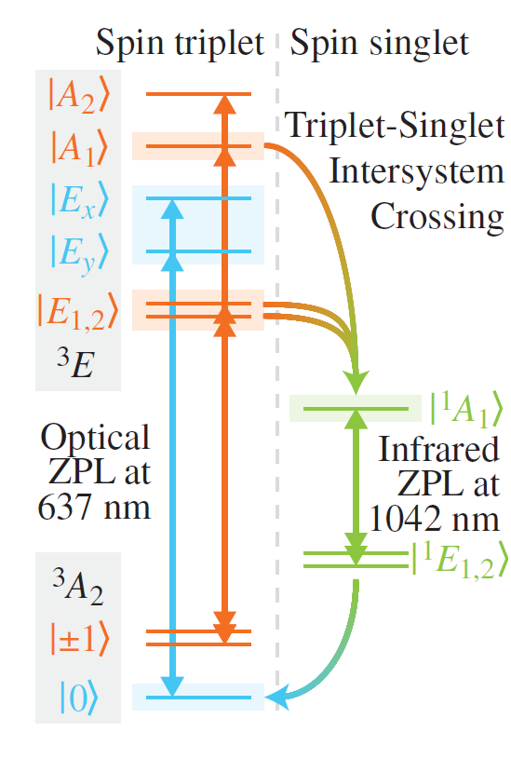
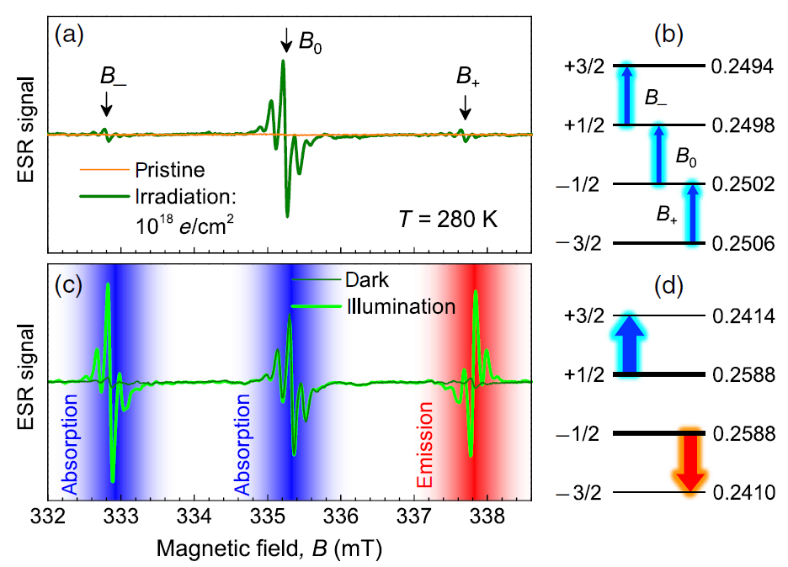
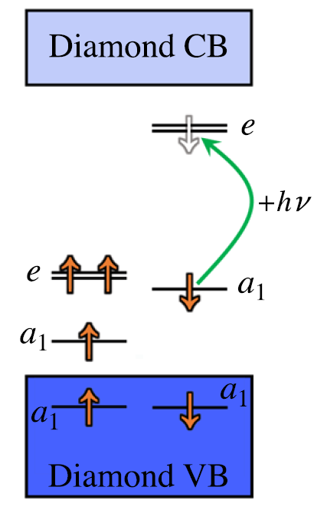
NV⁻ centre and more
NV⁻ centre in diamond is a well-established solid-state quantum system.
New-generation defects like defect complexes in SiC or 2D crystals have emerged for scalable quantum technologies.
Electronic structure of NV⁻ centre
Microwave emission by spin defects in SiC
Resonance frequency in GHz
Magnetic spin splitting in GHz
Can we discover the frequency beyond GHz?
Physical Review Applied 9.5 (2018): 054006.
Nanophotonics 8, 1907–1943 (2019).
Notes:
Fischer, M., et al. "Highly efficient optical pumping of spin defects in silicon carbide for stimulated microwave emission." Physical Review Applied 9.5 (2018): 054006.
Gali, Á. Ab initio theory of the nitrogen-vacancy center in diamond. Nanophotonics 8, 1907–1943 (2019).

Slide 4
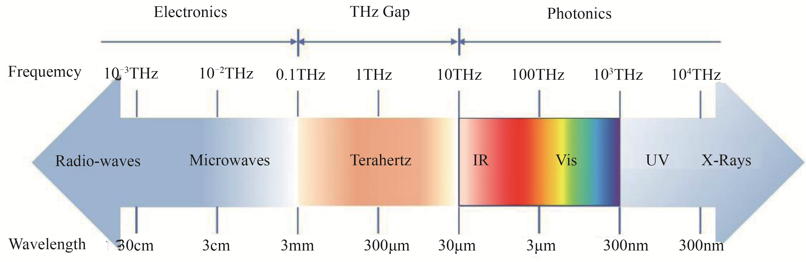
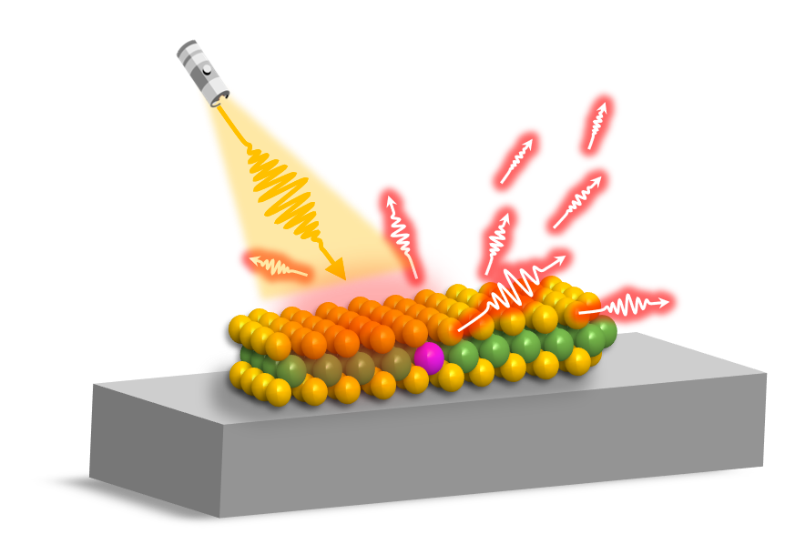
Quantum THz technologies
Terahertz wave:
Important for imaging, sensing, and 6G communications
Technology less mature than other wavelengths
Single-photon THz emitters:
THz photonic cavity with population inversion
Bring THz communication to additional control in quantum regime
THz spin qubit:
Longer spin relaxation time for robust quantum memory technologies at room temperature
Boost fidelity by resonant optical excitation
Optical excitation
THz emission
J Phys D Appl Phys 50, 043001 (2017).
PRX Quantum 5, 010312 (2024).
Notes:
Dhillon, S. S. et al. The 2017 terahertz science and technology roadmap. J Phys D Appl Phys 50, 043001 (2017).
Groiseau, C., Domínguez, A. I. F., Cano, D. M. & Muñoz, C. S. Single-photon source over the terahertz regime. arXiv preprint arXiv:2305.11754 (2023).
Schulte, K. A., Vignesh, K. R. & Dunbar, K. R. Effects of coordination sphere on unusually large zero field splitting and slow magnetic relaxation in trigonally symmetric molecules. Chem Sci 9, 9018–9026 (2018).
Robledo, L. et al. High-fidelity projective read-out of a solid-state spin quantum register. Nature 477, 574–578 (2011).

Slide 5
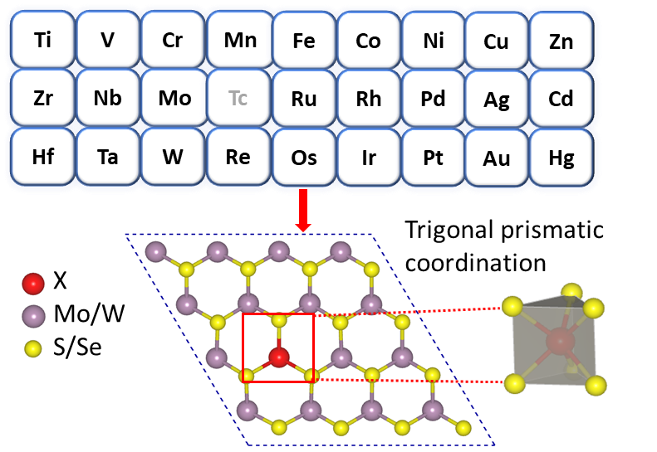
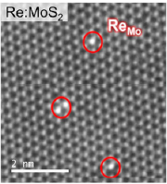
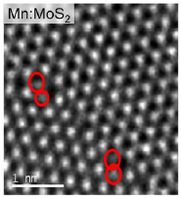
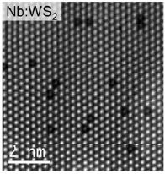
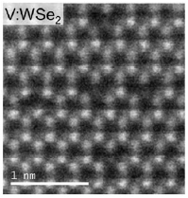
Transition metal defects in 2D TMDs
TM substitutional defects:
Heavier elements -> strong spin-orbit coupling (SOC) for large splitting
Magnetism-> high spin state
Multivalences -> both spin and charge degree of freedom
2D transition metal dichalcogenides (TMDs): promising host platform
Thin with easier integration
High light extraction efficiencies
Semiconducting with gate tunability
Scalable and controllable TM incorporation (MOCVD, CVT…)
Appl Phys Rev 7, 031308 (2020).
Nano Res 14, 1668–1681 (2021).
Notes:
Ping, Y. & Smart, T. J. Computational design of quantum defects in two-dimensional materials. Nat Comput Sci 1, 646–654 (2021).
Zhang, G., Cheng, Y., Chou, J.-P. & Gali, A. Material platforms for defect qubits and single-photon emitters. Appl Phys Rev 7, 031308 (2020).
Loh, L., Zhang, Z., Bosman, M. & Eda, G. Substitutional doping in 2D transition metal dichalcogenides. Nano Res 14, 1668–1681 (2021).

Slide 6
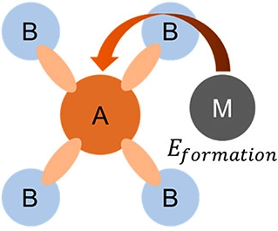
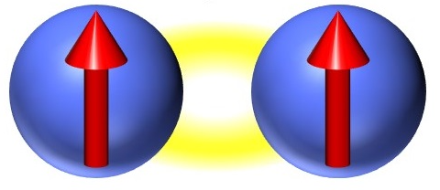
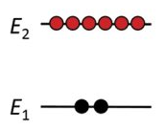
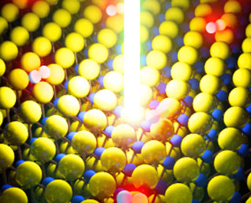
First-principles materials discovery
Criteria for novel quantum defects
Stability
VASP
Density functional theory (DFT):
Charged defects
Spin multiplicity
Single-particle band structures
Zero-field splitting (ZFS) contributed by spin-spin and spin-orbit interactions
Constrained DFT:
Excited-state energies
Group theory analysis
Many-body states
Symmetry-allowed transitions
Spin-triplet
THz-splitting
Excited-states
THz application

Slide 7
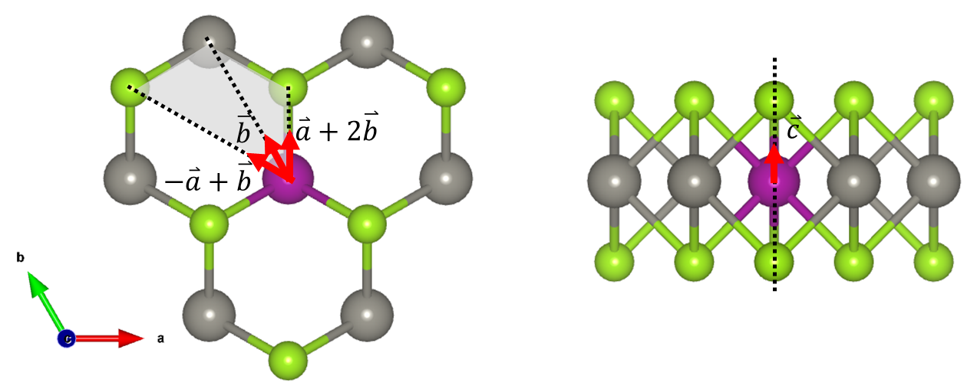
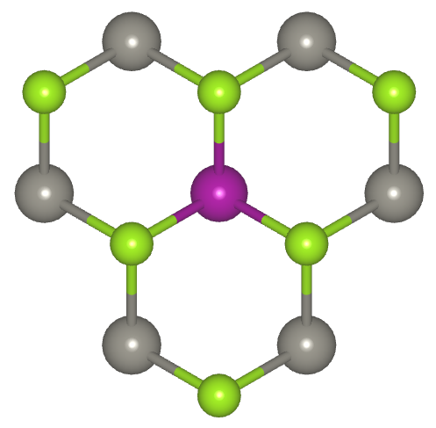
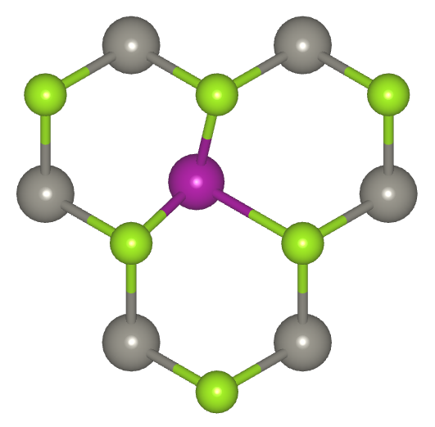
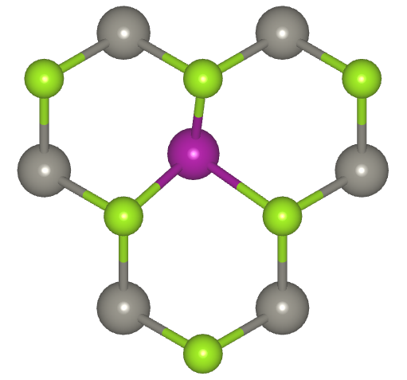
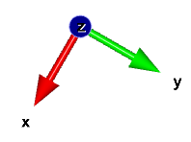
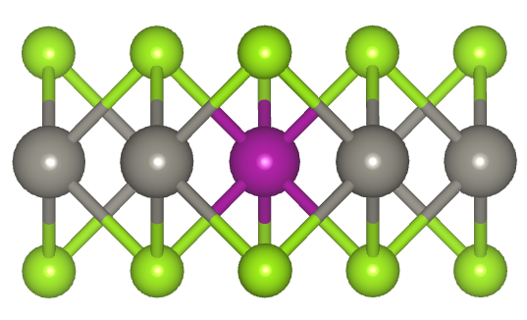
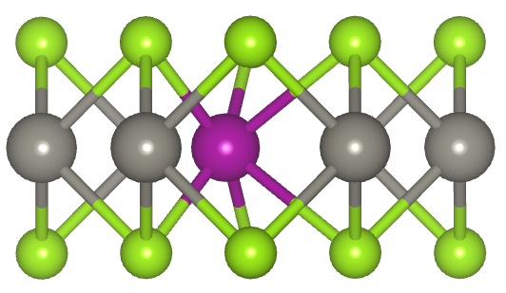
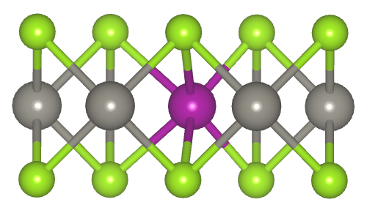
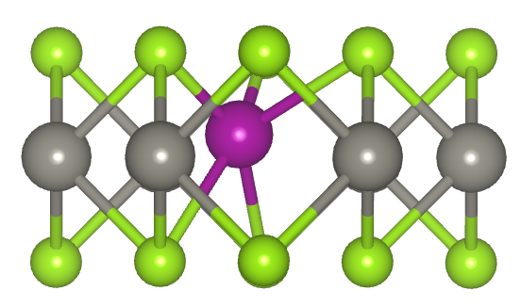
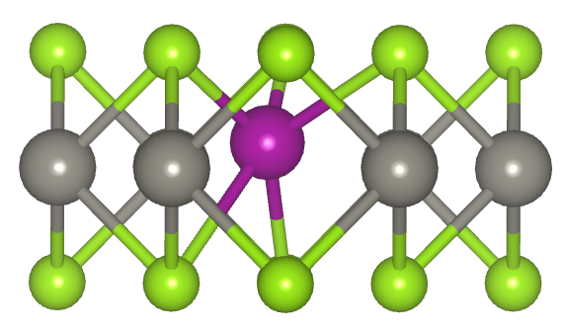
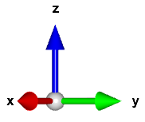
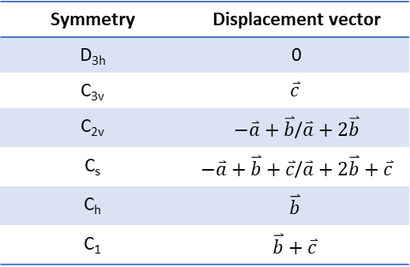
Local defect geometries
Symmetry | Displacement vector
D_{3h} | 0
C_{3v} | $$\overset{⃑}{c}$$
C_{2v} | $−\overset{⃑}{a}+\overset{⃑}{b}$/$\overset{⃑}{a}+2\overset{⃑}{b}$
C_{s} | $−\overset{⃑}{a}+\overset{⃑}{b}+\overset{⃑}{c}$/$\overset{⃑}{a}+2\overset{⃑}{b}+\overset{⃑}{c}$
C_{h} | $$\overset{⃑}{b}$$
C₁ | $$\overset{⃑}{b}+\overset{⃑}{c}$$
Fully-relaxed local atomic structures
D_{3h}
C_{2v}
C_{h}
C_{s}
C₁
σ_{v}
C₂
C₂
C₂
C₃(S₃)
σ_{v}
σ_{v}
σ_{yz}
σ_{s}
C₂
σ_{yz}
σ_{s}
C₂
σ_{h}
σ_{h}
σ_{xy}
C₃(S₃)
Notes:
Jingda started with a same C1 symmetry and relaxed for PBE and PBE+U.
For HSE06 relaxations, the starting point is with PBE/PBE+U relaxed structure.

Slide 8
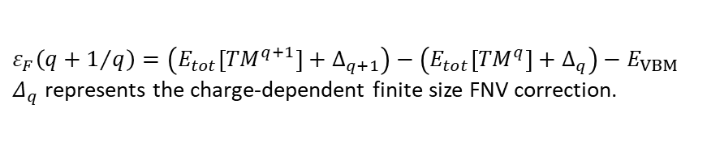
Defect charge transition levels
$ε_{F}\left(q+1/q\right)=\left(E_{tot}\left[{TM}^{q+1}\right]+∆_{q+1}\right)−\left(E_{tot}\left[{TM}^{q}\right]+∆_{q}\right)−E_{VBM}$
$Δ_{q}$ represents the charge-dependent finite size FNV correction.
Short line:
Pink (+1/0);
Green (0/-1);
Solid (PBE)
Dashed (PBE+U, 3 eV)
a
ML MoS₂
Conduction Band
_
_
_
_
_
_
_
0
_
_
_
_
_
_
_
_
_
_
_
_
0
_
_
0
0
0
0
0
0
0
0
0
0
0
0
0
0
0
+
0
0
0
+
+
+
+
0
+
0
0
0
0
+
+
+
+
+
Ti V Cr Mn Fe Co Ni Cu Zn Zr Nb Ru Rh Pd Ag Cd Hf Ta W Re Os Ir Pt Au Hg
Valence Band
b
ML WSe₂
Conduction Band
_
_
_
_
_
_
_
_
_
0
_
_
_
_
_
_
_
_
_
_
0
_
_
0
0
0
0
0
0
0
0
0
0
+
0
0
0
0
0
0
+
0
0
0
+
0
0
+
+
0
0
+
+
Ti V Cr Mn Fe Co Ni Cu Zn Zr Nb Mo Ru Rh Pd Ag Cd Hf Ta Re Os Ir Pt Au Hg
Valence Band

Slide 9
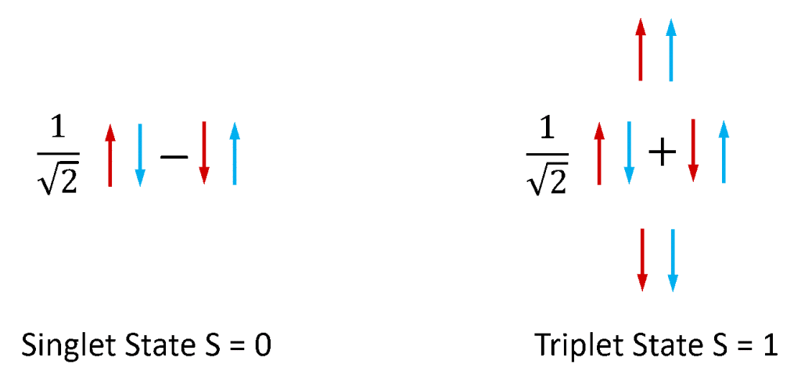
Spin-triplet quantum defect candidates
Spin-triplet defect configuration (S = 1) by HSE06
TM defect | Charge state | Symmetry | ΔE (Singlet-Triplet) (eV)
Host - MoS₂
Mn | -1 | C_{2v} | 0.69
Fe | 0 | D_{3h} | 0.67
Cu | -1 | C₁ | 0.22
Host - WSe₂
Ti | 0 | C_{2v} | 0.01
Mn | -1 | D_{3h} | 0.83
Fe | 0 | D_{3h} | 0.61
Cu | -1 | C₁ | 0.08
Cd | 0 | C_{2v} | 0.01

Slide 10
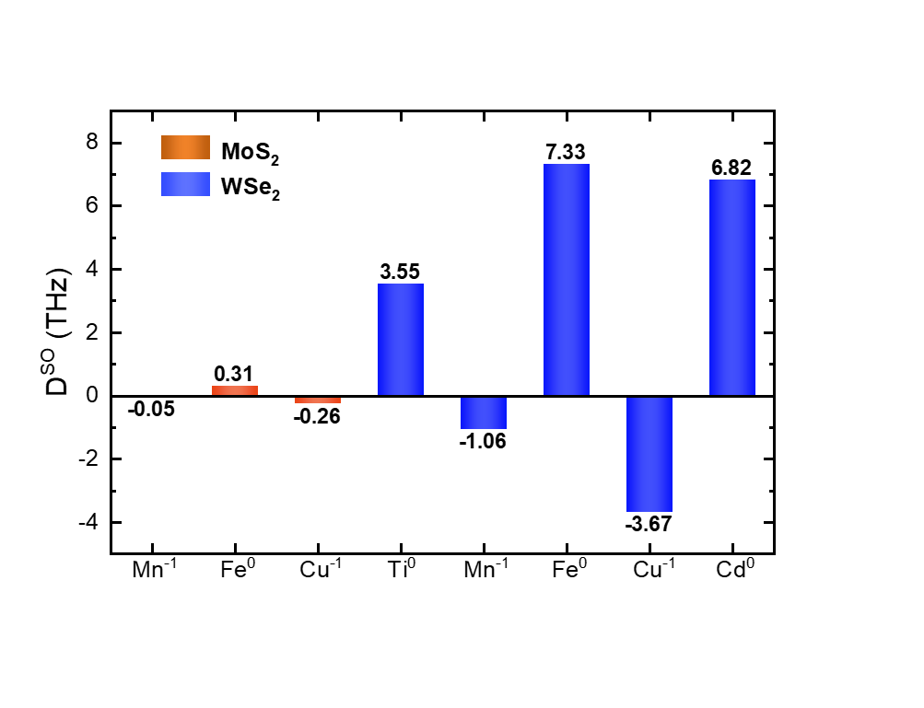
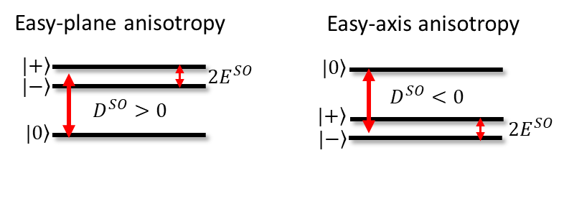
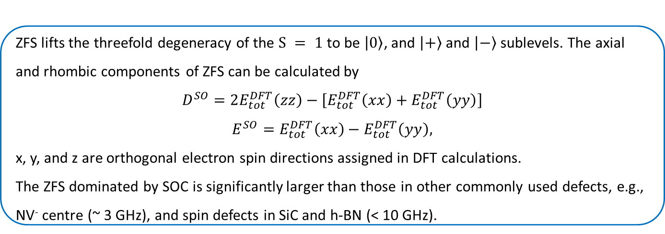
Zero-field splitting in THz
ZFS lifts the threefold degeneracy of the $S = 1$ to be $\left|\left.0\right\rangle \right.$, and $\left|\left.+\right\rangle \right.$ and $\left|\left.−\right\rangle \right.$ sublevels. The axial and rhombic components of ZFS can be calculated by
$$D^{SO}=2E_{tot}^{DFT}\left(zz\right)−\left[E_{tot}^{DFT}\left(xx\right)+E_{tot}^{DFT}\left(yy\right)\right]$$
$$E^{SO}=E_{tot}^{DFT}\left(xx\right)−E_{tot}^{DFT}\left(yy\right),$$
x, y, and z are orthogonal electron spin directions assigned in DFT calculations.
The ZFS dominated by SOC is significantly larger than those in other commonly used defects, e.g., NV⁻ centre (~ 3 GHz), and spin defects in SiC and h-BN (< 10 GHz).
Phys Rev X 7, 021046 (2017).
Nat Commun 12, 4480 (2021).
Notes:
1. Christle, D. J. et al. Isolated spin qubits in SiC with a high-fidelity infrared spin-to-photon interface. Phys Rev X 7, 021046 (2017).
2. Gottscholl, A. et al. Spin defects in hBN as promising temperature, pressure and magnetic field quantum sensors. Nat Commun 12, 4480 (2021).

Slide 11
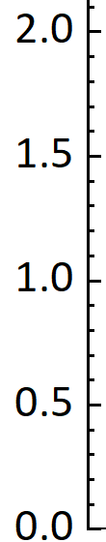
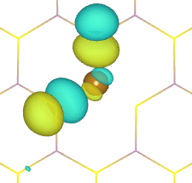
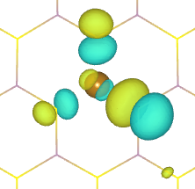
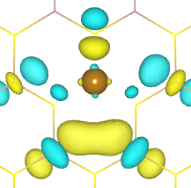
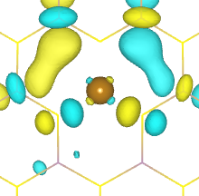
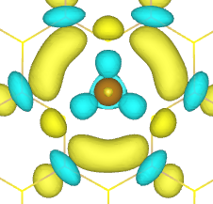
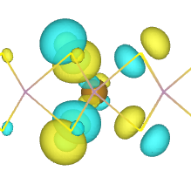
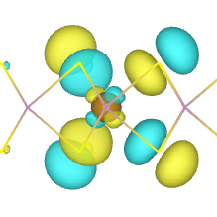
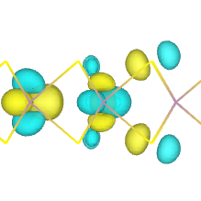
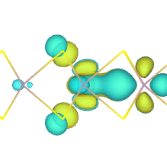
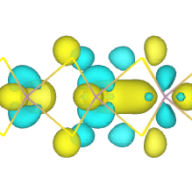
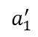
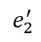
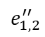
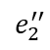












D_{3h} E 2C₃ 3C₂’ σ_{h} 2S₃ 3σ_{v} linear quadratic
Electronic structures and many-body level structures of Fe⁰-MoS₂ by HSE06
A₁’ +1 +1 +1 +1 +1 +1 x²+y², z²
A₂’ +1 +1 -1 +1 +1 -1 R_{z}
E’ +2 -1 0 2 -1 0 (x, y) (x²-y², xy)
A”₁ +1 +1 +1 -1 -1 -1
CB
A”₂ +1 +1 -1 -1 -1 +1 z
E” +2 -1 0 -2 +1 0 (R_{x}, R_{y}) (xz, yz)
S = 1
$$a_{1}^{′}$$
…
…
E-E_{VBM} (eV)
$$e_{1,2}^{′}$$
⁶E”
$${\left|μ_{k}\right|}^{2}=2.5 D2$$
$$e_{1,2}^{′′}$$
VB
ZPL (R_{x}, R_{y}) 0.90 eV
$$e_{1}^{′′}$$
$$e_{2}^{′′}$$
$$e_{1}^{′}$$
$$e_{2}^{′}$$
$$a_{1}^{′}$$
$$|\left.±\right\rangle$$
E”_{1,2}
³A’₂
ZFS_{g}
0.3 THz
$$|\left.0\right\rangle$$
A’₁
$$d_{xz}$$
$$d_{yz}$$
$$d_{xy}$$
$d_{x^{2}−y^{2}}$
$$d_{z2}$$

Slide 12























D_{3h} E 2C₃ 3C₂’ σ_{h} 2S₃ 3σ_{v} linear quadratic
Electronic structures and many-body level structures of Mn⁻¹-WSe₂ by HSE06
A₁’ +1 +1 +1 +1 +1 +1 x²+y², z²
A₂’ +1 +1 -1 +1 +1 -1 R_{z}
E’ +2 -1 0 2 -1 0 (x, y) (x²-y², xy)
A”₁ +1 +1 +1 -1 -1 -1
A”₂ +1 +1 -1 -1 -1 +1 z
CB
E” +2 -1 0 -2 +1 0 (R_{x}, R_{y}) (xz, yz)
S = 1
…
…
$$a_{1}^{′}$$
E-E_{VBM} (eV)
$$e_{1,2}^{′}$$
⁶E”
$${\left|μ_{k}\right|}^{2}= 3.6 D2$$
$$e_{1,2}^{′′}$$
VB
ZPL (R_{x}, R_{y}) 0.58 eV
$$e_{1}^{′′}$$
$$e_{2}^{′′}$$
$$e_{1}^{′}$$
$$e_{2}^{′}$$
$$a_{1}^{′}$$
$$|\left.0\right\rangle$$
A’₁
³A’₂
ZFS_{g}
1.1 THz
$$|\left.±\right\rangle$$
E”_{1,2}
$$d_{xz}$$
$$d_{yz}$$
$d_{x^{2}−y^{2}}$
$$d_{xy}$$
$$d_{z2}$$

Slide 13






https://physics.uwo.ca/~mhoude2/courses/PDF%20files/astro9701/Appendix_2.pdf

Slide 14



Defect state requirements
NV- center: μ = 4.49 D.
The break of exciton quenches PL at high T.
The first excitation with valence band (exciton) is optically forbidden.
The next allowed one is between two localized defect states.
The defect transition is symmetry ‘protected’ from detrimental radiative recombinations to band edges states by optical selection rules.
Mn⁻¹-MoS₂/WSe₂
Nb⁻¹-WS₂
Ti⁰-WSe₂

Slide 15
Mn⁻¹-MoS₂
Ti⁰-WSe₂
Cd⁰-WSe₂
a₁
a₁
b₂
a₁
(9.3,6.1,0) D^2
(53.4,36.5,0) D^2
a₁
(18.7,50.8,0) D^2
a₁
a₁
b₂
b₂

Slide 16




















THz emitter
C_{2v} E C₂ σ_{v}(yz) σ_{v}(xy) linear quadratic
Electronic structures and many-body level structures of Ti⁰-WSe₂ by HSE06
A₁ +1 +1 +1 +1 y x², y², z²
A₂ +1 +1 -1 -1 R_{y} xz
B₁ +1 -1 +1 -1 z, R_{x} yz
B₂ +1 -1 -1 +1 x, R_{z} xy
CB
S = 1
S = 0
$$|\left.0\right\rangle$$
B₂
E-E_{VBM} (eV)
³A₁
18.6 THz
$${2a}_{1}$$
A₂
$$Γ_{i}⨂Γ_{SOC}⨂Γ_{f}⊅A$$
$$b_{2}$$
$$|\left.±\right\rangle$$
B₁
$${\left|μ_{k}\right|}^{2}=89.9 D2$$
$$a_{1}$$
VB
ZPL_{0/±} (x,y) 0.55/0.46 eV
$$a_{1}$$
$$b_{2}$$
$${2a}_{1}$$
B₁
¹A₁
$$|\left.±\right\rangle$$
A₂
³B₂
|ZFS_{g}|
3.6 THz
$$|\left.0\right\rangle$$
A₁
$d_{x^{2}−y^{2}}$
$$d_{xy}$$
$$d_{z2}$$

Slide 17
















THz qubit
Electronic structures and many-body level structures of Mn⁻¹-MoS₂ by HSE06
C_{2v} E C₂ σ_{v}(yz) σ_{v}(xz) linear quadratic
A₁ +1 +1 +1 +1 z x², y², z²
A₂ +1 +1 -1 -1 R_{z} xy
B₁ +1 -1 +1 -1 y, R_{x} yz
B₂ +1 -1 -1 +1 x, R_{y} xz
CB
$$|\left.+\right\rangle$$
A₂
0.3 THz
³B₂
$$|\left.−\right\rangle$$
A₁
E-E_{VBM} (eV)
$${2a}_{1}$$
0.3 THz
$${\left|μ_{k}\right|}^{2}=15.4 D2$$
$$|\left.0\right\rangle$$
B₁
$${1a}_{1}$$
$$b_{2}$$
ZPL_{0/±} (x,y) 0.61 eV
VB
$$b_{2}$$
$${1a}_{1}$$
$${2a}_{1}$$
$$|\left.0\right\rangle$$
B₁
|ZFS_{g}|
0.05 THz
³B₂
A₁
$$|\left.±\right\rangle$$
A₂
$$d_{xz}$$
$d_{x^{2}−y^{2}}$
$d_{z^{2}}$

Slide 18
Outlook for THz quantum defects
Conceptual design
Conduction band
The spin state can be read out by the photoluminescence frequency, and the intensity.
ZFS of ground and excited states in THz with opposite signs can boost the fidelity for qubits controlled by resonant excitation.
This study paves the way for breakthroughs in quantum THz technology.
Excited state
S=1
THz emitter
Infrared pumping
THz qubit control
Ground state
S = 1
Valence band

Slide 19





Acknowledgement
Prof. Su Ying Quek and group
Research facilities
Prof. Goki Eda
Thank you for your attention!
Email: jingda@u.nus.edu

Slide 20


Computational details
PBE exchange-correlation functional (with an on-site Hubbard U of 3 eV for 3d elements) for preliminary screening and HSE06 functional for further validation
PAW energy cutoff: 450 eV
Supercell of ML TMDs: 4×4 (qualitatively agree with 6×6)
Γ-centred k-mesh: 3×3×1
Force convergence criterion: 0.01 eV/Å for PBE and 0.02 eV/Å for HSE06
Energy convergence criterion in SCF cycle: 10⁻⁵ eV
Vacuum height: 15 Å
FNV finite-size correction by sxdefectalign2d code
“LDMATRIX” tag used in SS-contributed ZFS calculations
SOC nonself-consistently included in the SO-contributed ZFS calculations
Optical transition energies by constrained DFT method
PyVaspwfc for post-processing of wavefunction visualization in VESTA
Group theory analysis for configuring many-body states and determining symmetry-allowed transitions

Slide 21

Zero-field splitting. The first order ZFS contributed by spin-spin dipole interactions is calculated by adding the hidden tag “LDMATRIX” implemented in VASP.
The second-order SOC-contributed ZFS has the spin Hamiltonian of
$${\hat{H}}_{ZFS}=D^{SO}\left({\hat{S}}_{z}^{2}−\frac{1}{3}S\left(S+1\right)\right)+E^{SO}\left({\hat{S}}_{x}^{2}−{\hat{S}}_{y}^{2}\right)={\hat{D}}^{SO}+{\hat{E}}^{SO},$$
which yields, for $S=1$, $\frac{1}{3}D^{SO}+E^{SO}$, $\frac{1}{3}D^{SO}−E^{SO}$, and $−\frac{2}{3}D^{SO}$ for $\left|\left.+\right\rangle \right.$, $\left|\left.−\right\rangle \right.$ and $\left|\left.0\right\rangle \right.$ eigenstates, respectively (see main text).
For a single spin, with the spin-quantization axis in the z-direction, and spin states $\left|\left.z\right\rangle \right.≡\left|\left.↑\right\rangle \right.$ and $\left|\left.−z\right\rangle \right.≡\left|\left.↓\right\rangle \right.$, we have
$$\left|\left.x\right\rangle \right.=\frac{1}{\sqrt{2}}\left(\left|\left.↑\right\rangle \right.+\left|\left.↓\right\rangle \right.\right),$$
$$\left|\left.y\right\rangle \right.=\frac{1}{\sqrt{2}}\left(\left|\left.↑\right\rangle \right.+i\left|\left.↓\right\rangle \right.\right).$$
Thus, for two spins in the $S=1$ system,
$$\left|\left.xx\right\rangle \right.=\left|\left.x\right\rangle \right.⊗\left|\left.x\right\rangle \right.=\frac{1}{2}\left(\left|\left.↑↑\right\rangle \right.+\left|\left.↓↓\right\rangle \right.\right)+\frac{1}{2}\left(\left|\left.↑↓\right\rangle \right.+\left|\left.↓↑\right\rangle \right.\right),$$
$$\left|\left.yy\right\rangle \right.=\left|\left.y\right\rangle \right.⊗\left|\left.y\right\rangle \right.=\frac{1}{2}\left(\left|\left.↑↑\right\rangle \right.−\left|\left.↓↓\right\rangle \right.\right)+\frac{1}{2}i\left(\left|\left.↑↓\right\rangle \right.+\left|\left.↓↑\right\rangle \right.\right).$$
Therefore, using the Hamiltonian ${\hat{H}}_{ZFS}+{\hat{H}}_{elec},$ the total energies are:
$$E_{tot, xx}^{DFT}=−\frac{1}{6}D^{SO}+\frac{1}{2}E^{SO}+E_{el},$$
$$E_{tot,yy}^{DFT}=−\frac{1}{6}D^{SO}−\frac{1}{2}E^{SO}+E_{el},$$
$$E_{tot,zz}^{DFT}=\frac{1}{3}D^{SO}+E_{el},$$
where $E_{el}$ is introduced as the total electronic energy, which we assume to be independent of the orientation of the spins. Now, the value of $D^{SO}$ and $E^{SO}$ can be directly calculated by DFT through:
$$D^{SO}=2E_{tot,zz}^{DFT}−\left[E_{tot,xx}^{DFT}+E_{tot,yy}^{DFT}\right],$$
$$E^{SO}=E_{tot,xx}^{DFT}−E_{tot,yy}^{DFT}.$$
For the calculation of total energies, we first carry out a self-consistent collinear calculation without SOC. Reading from the ground-state charge density of the system, the SOC can be treated as a perturbation in non-self-consistent calculations. The total energy of the system is self-consistently calculated including SOC with a convergence threshold of 10⁻⁹ eV for different spin orientations.

Slide 22
MoS₂ | CTL (+1/0) (eV) | CTL (0/-1) (eV)
Ti | -0.40 (-0.39) | 0.67 (0.70)
V | -0.39 (-0.43) | 0.56 (0.65)
Cr | -0.44 (-0.30) | 1.88 (1.48)
Mn | 0.57 (0.30) | 1.55 (1.33)
Fe | 0.39 (0.07) | 1.42 (1.09)
Co | 0.24 (0.07) | 1.20 (1.31)
Ni | 0.08 (0.06) | 1.19 (1.18)
Cu | 0.06 (0.04) | 1.10 (1.08)
Zn | -0.08 (-0.10) | 0.94 (0.92)
Zr | -0.42 | 0.65
Nb | -0.39 | 0.51
Ru | 0.63 | 1.88
Rh | 0.57 | 1.25
Pd | 0.18 | 1.32
Ag | 0.16 | 1.12
Cd | -0.03 | 1.01
Hf | -0.41 | 0.66
Ta | -0.38 | 0.52
W | -0.44 | 2.30
Re | 1.24 | 2.05
Os | 0.73 | 2.02
Ir | 0.79 | 1.30
Pt | 0.22 | 1.34
Au | 0.33 | 1.30
Hg | 0.11 | 1.11
WSe₂ | CTL (+1/0) (eV) | CTL (0/-1) (eV)
Ti | -0.43 (-0.41) | 0.43 (0.47)
V | -0.51 (-0.39) | 0.34 (0.48)
Cr | -0.55 (-0.35) | 1.51 (1.17)
Mn | 0.39 (0.16) | 1.24 (0.99)
Fe | 0.26 (-0.08) | 1.22 (0.88)
Co | 0.21 (-0.02) | 0.97 (1.03)
Ni | -0.03 (-0.22) | 0.94 (0.86)
Cu | 0.01 (-0.03) | 0.88 (0.87)
Zn | -0.16 (-0.17) | 0.68 (0.67)
Zr | -0.45 | 0.40
Nb | -0.53 | 0.29
Mo | -0.57 | 1.98
Ru | 0.42 | 1.55
Rh | 0.43 | 0.98
Pd | 0.04 | 1.03
Ag | 0.04 | 0.83
Cd | -0.12 | 0.78
Hf | -0.44 | 0.42
Ta | -0.51 | 0.31
Re | 0.97 | 1.60
Os | 0.48 | 1.68
Ir | 0.55 | 1.06
Pt | 0.05 | 1.04
Au | 0.18 | 1.07
Hg | -0.02 | 0.84

Slide 23


PBE+U | Symmetry | MAE axis | D^{SO}(GHz) | D^{SS}(GHz) | E^{SO}(GHz) | E^{SS}(GHz) | D^{tot}(THz)
Host - MoS₂
Mn⁻¹ | C_{2v} | (0 0 1) | -284.8 | 37.8 | -10.6 | 0.9 | -0.25
Fe⁰ | C_{h} | (0 0 1) | 409.2 | -8.8 | 0.1 | -0.0 | 0.40
Cu⁻¹ | C_{s} | (0 0 1) | -145.6 | -2.2 | 0.1 | -0.4 | -0.15
Cd⁰ | D_{3h} | (0 0 1) | 2797.8 | 1.0 | 0.0 | 0.0 | 2.80
Hg⁰ | D_{3h} | (0 0 1) | 8255.8 | 1.0 | 0.1 | 0.0 | 8.26
Host - WSe₂
Ti⁰ | C_{2v} | (0 0 1) | -2134.2 | 1.1 | -7.8 | 0.1 | -2.13
Mn⁻¹ | C_{h} | (0 0 1) | -1892.4 | -23.5 | 50.3 | -0.7 | -1.92
Fe⁰ | C_{h} | (0 0 1) | 7431.0 | -5.6 | -0.1 | -0.1 | 7.43
Cu⁻¹ | C_{s} | ($\sqrt{3}$ -1 0) | 491.7 | -1.5 | 9.6 | -0.4 | 0.49
Cd⁰ | D_{3h} | (0 0 1) | 11638.5 | 0.9 | 0.4 | 0.0 | 11.64
PBE+U | Charge state | Symmetry | ΔE (Singlet-Triplet) (eV)
Host - MoS₂
Mn | -1 | C_{2v} | 0.60
Fe | 0 | C_{h} | 0.40
Cu | -1 | C_{s} | 0.01
Cd | 0 | D_{3h} | 0.03
Hg | 0 | D_{3h} | 0.02
Host - WSe₂
Ti | 0 | C_{2v} | 0.02
Mn | -1 | C_{h} | 0.81
Fe | 0 | C_{h} | 0.53
Cu | -1 | C_{s} | 0.03
Cd | 0 | D_{3h} | 0.02
HSE06 | Symmetry | MAE axis | D^{SO}(GHz) | D^{SS}(GHz) | E^{SO}(GHz) | E^{SS}(GHz) | D^{tot}(THz)
Host - MoS₂
Mn⁻¹ | C_{2v} | ($\sqrt{3}$ -1 0) | -52.9 | 19.7 | -9.5 | 10.0 | -0.06
Fe⁰ | D_{3h} | (0 0 1) | 306.8 | 16.3 | 0.7 | 0.0 | 0.32
Cu⁻¹ | C₁ | (0 0 1) | -261.6 | 0.1 | -39.8 | -1.7 | -0.26
Host - WSe₂
Ti⁰ | C_{2v} | (0 0 1) | 3553.7 | 0.9 | -28.7 | 0.1 | 3.55
Mn⁻¹ | D_{3h} | (0 0 1) | -1064.5 | 24.5 | -35.4 | 0.2 | -1.10
Fe⁰ | D_{3h} | (0 0 1) | 7329.7 | 10.7 | 0.4 | 0.1 | 7.34
Cu⁻¹ | C₁ | (0 0 1) | -3670.7 | 0.5 | 12.0 | 1.4 | -3.66
Cd⁰ | D_{3h} | (0 0 1) | 6822.3 | 0.9 | 1.5 | 0.0 | 6.82

Slide 24
Mn⁻¹-WSe₂
(6x6 cell scf by HSE06 relaxed by PBE+U)
(4x4 cell relaxed by HSE06)
(4x4 cell by HSE06+SOC)
(0,0,3.6) D^2
mag= -0.0001 -0.0002 2.0213

Slide 25
Fe⁰-MoS₂
(6x6 cell scf by HSE06 relaxed by PBE+U)
(4x4 cell relaxed by HSE06)
(4x4 cell by HSE06+SOC)
(0,0,2.5) D^2
mag= 0.0000 0.0000 1.9984

Slide 26
Fe⁰-MoS₂ by PBE+U
Fe⁰-MoS₂ (S = 0)
S = 1
S = 0

Slide 27
Fe⁰-WSe₂
(6x6 cell scf by HSE06 relaxed by PBE+U)
(4x4 cell relaxed by HSE06)
a’
a’
(0,0,3.3) D^2
a”
a”

Slide 28

ML MoS2
EXP bandgap~ 1.9 eV
CALC by PBE: 1.68 eV
CALC by HSE06+SOC: 1.97 eV
CALC by HSE06: 2.03 eV
ML WSe2
EXP bandgap~ 1.7 eV
CALC by PBE: 1.54 eV
CALC by HSE06+SOC: 1.62 eV
CALC by HSE06: 1.90 eV
Formation energy of TM defect:
$$E^{f}\left[{TM}_{Mo/W}^{q}\right]=E_{tot}\left[{TM}_{Mo/W}^{q}\right]−E_{tot}\left[Pristine\right]+μ_{{Mo}/W} −μ_{TM}+q\left(ε_{F}+E_{VBM}\right)+Δ_{q}.$$
Note that the formation energies are determined with chemical potential $μ$ under constraint conditions:
$$μ_{M}+2μ_{X}=E_{tot}\left[MX_{2}\right],$$
$$μ_{TM}+μ_{X}≤E_{tot}\left[\left(TM\right)X\right],$$
$$μ_{M}≤E_{tot}\left[M\right],$$
$$μ_{X}≤E_{tot}\left[X\right],$$
$$μ_{TM}≤E_{tot}\left[TM\right].$$
Here, M = Mo/W, X = S/Se, TM = Fe/Mn. The boundary for the least limit of formation energy can be derived as:
${\left(μ_{M}−μ_{TM}\right)}_{min}=E_{tot}\left[MX_{2}\right]−E_{tot}\left[\left(TM\right)X\right]−E_{tot}[X]$.
To avoid the uncertainty of $μ_{TM}$ values from experiments, we also demonstrate the energy difference between TM forming as substitution or as the interstitial (adsorption above Mo/W or S/Se atom) by PBE+U calculation, which can be expressed by
$$∆E^{f}=E_{sub}^{f}−\left(E_{vac}^{f}+E_{int}^{f}\right)=\left(E_{tot}\left[{TM}_{Mo/W}\right]+E_{tot}\left[Pristine\right]\right)−\left(E_{tot}\left[Vac_{Mo/W}\right]+E_{tot}\left[TM_{ad}\right]\right)$$
with
$$E_{sub}^{f}=E_{tot}\left[TM_{Mo/W}\right]−E_{tot}\left[Pristine\right]+μ_{{Mo}/W} −μ_{TM},$$
$$E_{vac}^{f}=E_{tot}\left[{Vac}_{Mo/W}\right]−E_{tot}\left[Pristine\right]+μ_{{Mo}/W},$$
$$E_{int}^{f}=E_{tot}\left[TM_{ad}\right]−E_{tot}\left[Pristine\right] −μ_{TM}.$$
The $∆E^{f}$for Fe⁰ in MoS₂ and Mn⁰ in WSe₂ are is -6.31 eV and -5.90 eV, respectively. This indicates that with the introduction of TM impurities, the formation of substitutional defects is energetically more favourable.

Slide 29
Discussion:
HSE06 relaxations start from PBE relaxed structure. The PBE structures with 3d dopants are different from HSE06 relaxed ones, especially for Mn, Fe and Co. However, PBE+U gives much better results. This can be seen from CTLs by PBE+U.
The values in bracket on Sin-Tri gap stand for another S=0 state (defect position closer to triplet). Co-1-WSe2 prefers to form quintet state over triplet (lower by 0.16 eV).
U is set to be 3 eV for 3d dopant elements, performing as a proper correction (also studied in literatures). Linear response is for now not necessary.
MoS₂ | PBE+U |  |  | HSE06
 | Symmetry | ΔE (Singlet-Triplet) (eV) | Triplet dopant position | Symmetry | ΔE (Singlet-Triplet) (eV) | Triplet dopant position
Mn⁻¹ | C_{2v} | 0.60 | 0.328,0.422,0.500 | C_{2v} | 0.69 | 0.328,0.421,0.500
Fe⁰ | D_{3h} | 0.40 (0.52) | 0.333,0.417,0.501 | D_{3h} | 0.67 | 0.333,0.417,0.500
Cu⁻¹ | C_{s} | 0.01 (0.06) | 0.315,0.439,0.511 | C₁ | 0.22 | 0.316,0.438,0.511
Cd⁰ | D_{3h} | 0.03 | 0.333,0.417,0.501 |  | 0.00
Hg⁰ | D_{3h} | 0.02 | 0.333,0.417,0.507 |  | 0.00
WSe₂ | PBE+U |  |  | HSE06
 | Symmetry | ΔE (Singlet-Triplet) (eV) | Triplet dopant position | Symmetry | ΔE (Singlet-Triplet) (eV) | Triplet dopant position
Ti⁰ | C_{2v} | 0.02 | 0.332,0.418,0.500 | C_{2v} | 0.01 | 0.331,0.419,0.500
Mn⁻¹ | C_{2v} | 0.81 | 0.327,0.430,0.501 | D_{3h} | 0.83 | 0.333,0.417,0.501
Fe⁰ | D_{3h} | 0.53 | 0.333,0.417,0.501 | D_{3h} | 0.61 | 0.333,0.417,0.500
Cu⁻¹ | C_{s} | 0.03 | 0.310,0.441,0.515 | C₁ | 0.08 | 0.312,0.440,0.512
Cd⁰ | D_{3h} | 0.02 | 0.333,0.417,0.501 | C_{2v}(D_{3h}) | 0.01 | 0.333,0.416,0.501

Slide 30





a
Ti
V
Cr
Mn
Fe
Co
Ni
Cu
Zn
Zr
Nb
Mo
Tc
Ru
Rh
Pd
Ag
Cd
Hf
Ta
W
Re
Os
Ir
Pt
Au
Hg
Trigonal prismatic coordination
X
Mo/W
S/Se
b
D_{3h}
C_{2v}
C_{h}
σ_{v}
C₂
C₂
C₂
C₃(S₃)
σ_{v}
σ_{v}
σ_{yz}
C₂
σ_{yz}
C₂
σ_{h}
σ_{h}
σ_{xy}
C₃(S₃)

Slide 31
a
ML MoS₂
Pink (+1/0) Green (0/-1)
Conduction Band
_
_
_
_
_
_
_
_
_
_
_
_
_
_
_
0
_
_
_
_
0
_
_
0
0
0
0
0
0
0
0
0
0
0
0
0
0
0
0
+
0
0
0
+
+
0
+
+
+
0
0
+
+
0
+
+
+
Ti V Cr Mn Fe Co Ni Cu Zn Zr Nb Ru Rh Pd Ag Cd Hf Ta W Re Os Ir Pt Au Hg
Valence Band
b
ML WSe₂
Conduction Band
_
_
_
_
_
_
_
_
_
0
_
_
_
_
_
_
_
_
_
_
0
_
_
0
0
0
0
0
0
0
0
+
0
0
0
0
0
0
0
0
+
0
0
0
+
0
0
+
+
0
0
+
+
Ti V Cr Mn Fe Co Ni Cu Zn Zr Nb Mo Ru Rh Pd Ag Cd Hf Ta Re Os Ir Pt Au Hg
Valence Band

Slide 32










a
Easy-plane anisotropy
Easy-axis anisotropy
$$|\left.+\right\rangle$$
$${2E}^{SO}$$
$$|\left.0\right\rangle$$
$$|\left.−\right\rangle$$
$$D^{SO}<0$$
$$D^{SO}>0$$
$$|\left.+\right\rangle$$
$$|\left.0\right\rangle$$
$$|\left.−\right\rangle$$
$${2E}^{SO}$$
b

Slide 33
Conceptual design for THz emitters for cover page
Conduction band
Near-infrared excitation
Excited state
S=1
THz emitter
THz emission
Meta-stable state S=0
ZPL
THz qubit control
ISC
Ground state
S = 1
Valence band
ZFS:
Zero-field splitting
ZPL:
Zero-phonon line
ISC: Intersystem crossing

Slide 34







$$\overset{⃑}{b}$$
$$\overset{⃑}{a}+2\overset{⃑}{b}$$
$$\overset{⃑}{c}$$
$$−\overset{⃑}{a}+\overset{⃑}{b}$$
By checking Rh-MoS2(-1) in 6*6 supercell, the same largely distorted geometry occurs, meaning it is not due to the supercell size. Therefore, we need a more reliable method for searching for the real ground state:
Based on the threefold symmetry of substitution site and supposing the a, b, c are unit vectors, the initial geometries choices can be confined in the shaded area.
For C1h/C1, the deviation direction is chosen towards a meta-site Mo/W along bisection angle in between the two C2v movements (0.333,0.417,0.500)->(0.333,0.437,0.520).
Repeat all the calculations from C1 for both S=0 and 1 by PBE:
-> only 2 calculations for each defect charge
-> obtaining CTLs and Sin-Tri gaps within a single batch.
-> energetically more stable configurations than the previous random disruptions for non-constraint spin calculations

Slide 35
Comparison of total energy between new and old method
MoS2 | chg | E (new-old eV)
Ti | +1 | 0.02
Zr | +1 | 0.02
Hf | +1 | 0.02
W | -1 | 0.04
Re | 0 | 0.03
Ir | 0 | 0.06
MoS2 | chg | E (new-old eV)
Co | -1 | -0.10
Ni | 0 | -0.35
Ni | -1 | -0.27
Cu | 0 | -0.09
Cu | -1 | -0.07
Cu | +1 | -0.07
Rh | -1 | -0.30
Pd | -1 | -0.02
Pd | +1 | -0.05
Ag | -1 | -0.07
Ir | -1 | -0.32
Pt | -1 | -0.12
Au | 0 | -0.02
Au | -1 | -0.01
Au | +1 | -0.04
WSe2 | chg | E (new-old eV)
Co | -1 | -0.10
Ni | 0 | -0.36
Ni | -1 | -0.32
Ni | +1 | -0.17
Cu | 0 | -0.13
Cu | -1 | -0.07
Cu | +1 | -0.17
Rh | -1 | -0.26
Ag | -1 | -0.12
Ir | -1 | -0.28
Pt | -1 | -0.10
Au | 0 | -0.09
Au | -1 | -0.04
Au | +1 | -0.07
WSe2 | chg | E (new-old eV)
V | 0 | 0.03
V | +1 | 0.03
Cr | +1 | 0.02
Fe | -1 | 0.07
Nb | 0 | 0.04
Mo | -1 | 0.04
Mo | +1 | 0.05
Ta | 0 | 0.03
Among 150 systems, 107 systems are very closed by new and old method. Systems with larger than 0.01 eV E_tot difference are listed. The old method do not constrain spin multiplicity.
14 systems (left) show slightly higher energy by new method, probably due to the optimized fractional total magnetic moments by old method. Only 4 systems (bold) may change the CTLs a bit, none of which affect our candidates.
29 systems (right) shows a lower energy by new method. Old method could not even obtain a right spin state (red).

Slide 36




Application based on ZFS of excited triplet states
In some spectroscopy experiments for organic molecules and theoretical prediction for TM complexes, the ZFS values of excited states can be significantly changed from ground state, even the sign:
J. Phys. Chem. 1992, 96, 6, 2486–2490. (Exp)
J. Phys. Chem. A 1999, 103, 17, 3155–3162. (Exp)
J. Chem. Theory Comput. 2012, 8, 7, 2344–2351. (Calc)
Chem. Sci., 2018, 9, 9018-9026. (Calc)
The D component difference between GS and ES can lead to the manipulation of spin Hamiltonian for quantum information process.
2.87 GHz vs 1.43 GHz for NV- centre; Phys. Rev. Lett. 101, 117601.
9.43 GHz vs 2.42 GHz in colour centre in SiC; Nature Physics volume 10, pages157–162 (2014).
This occurs obviously in 3d ion doped trigonal crystal field, e.g., ZnGa2O4:Cr3+.

Slide 37
Cd⁰-MoS₂ ZFS of excited state by PBE
VASP input for step(3)
ISMEAR = -2
EDIFF = 1e-9
ICHARG = 1
LCHARG = .FALSE.
LWAVE = .FALSE.
FERWE = 413*1.0 0.0 1.0 129*0.0 413*1.0 0.0 1.0 129*0.0 413*1.0 0.0 1.0 129*0.0 413*1.0 0.0 1.0 129*0.0 413*1.0 0.0 1.0 129*0.0 413*1.0 0.0 1.0 129*0.0 413*1.0 0.0 1.0 129*0.0 413*1.0 0.0 1.0 129*0.0 413*1.0 0.0 1.0 129*0.0
LDIAG = .FALSE.
LSORBIT = .TRUE.
SAXIS = 0 0 1/1 1.732 0/1.732 -1 0
Triplet ES
Method1: Tot_E
D_SO
-16273.7824136022 GHz
E_SO
3823.0033410819 MHz
Method2: E_soc
D_SO
-18425.1406824871 GHz
E_SO
-359.9019275809 MHz
VASP input for step(2)
EDIFF = 1e-9
ICHARG = 11
LCHARG = .FALSE.
LWAVE = .TRUE.
LSORBIT = .TRUE.
SAXIS = 0 0 1/1 1.732 0/1.732 -1 0
Triplet GS
Method1: Tot_E
D_SO
2797.7736486175 GHz
E_SO
-38.0467991705 MHz
Method2: E_soc
D_SO
4698.9114999086 GHz
E_SO
-40.8452999272 MHz
DFT calculation method:
Triplet GS without SOC
Non-SCF calculations based on three spin orientations
Read previous three WAVECARs for SCF calculations by cDFT, respectively
*The relaxed excited geometry exhibits approximately same ZFS value.

Slide 38

Ir-WSe2 CTLs by HSE06 with and without SOC
# CTL_1(+1/0)=E_0-(E_p1+FNV_p1)-E_VBM
# CTL_2(0/-1)=-E_0+(E_n1+FNV_n1)-E_VBM
HSE06soc: 1.62 eV gap
CTL_1(+1/0) 0.420
CTL_2(0/-1) 1.383
HSE06: 1.90 eV gap
CTL_1(+1/0) 0.759
CTL_2(0/-1) 1.698
Supercell size | 4×4 | 6×6
Defect properties | Ir⁻¹-WSe₂
CTL (+1/0) (eV) | 0.552 | 0.438
CTL (0/-1) (eV) | 1.486 | 1.440
Sin-Tri gap (eV) | 0.058 | 0.058
$D^{SO}$ (THz) | 8.694 | 7.914
ZPL_{T} (eV) | 0.439 | 0.456
Character tables
C_{h} E σ_{h} linear quadratic
A’ +1 +1 x, y, R_{z} x², y², z², xy
A” +1 -1 z, R_{x}, R_{y} xz, yz
Ir(-1)-WSe2 Band edge (VBM) alignment using core level
D_{3h}
$$E\left(def_{VBM}\right)=E\left(def_{core}\right)+E\left(pri_{VBM}\right)−E(pri_{core})$$
Energy
a₁’
(Numbers are relative to pri_VBM, respectively)
a₁’
Peak position of pDOS by chalcogen s electrons
D_{3h}
e_{x}’ e_{y}’
PBE
e_{x}’ e_{y}’
0.50 eV = -12.09 + 0 - (-12.59) eV
> 0.48 eV read VBM from the defect band structure
ΔE_VBM_corr = 0.02 eV
S = 1
S = 0
A”₂
PBEsoc
A”₁
0.50 eV = -12.33 + 0 - (-12.83) eV
> 0.39 eV read VBM from the defect band structure
ΔE_VBM_corr = 0.11 eV
³E’
E’_{x,y}
HSE06
E”_{1,2}
0.54 eV = -13.63 + 0 - (-14.17) eV
> 0.44 eV read VBM from the defect band structure
ΔE_VBM_corr = 0.10 eV
¹A’₁
ZPL
¹E’_{1,2}
HSE06soc
0.56 eV = -13.91 + 0 - (-14.47) eV
> 0.29 eV read VBM from the defect band structure
ΔE_VBM_corr = 0.26 eV
E”_{1,2}
³A’₂
ZFS
A’₁

Slide 39





Group theoretic approach for NV- center

Slide 40




Optical electron spin polarization cycle of NV- center
The nitrogen-vacancy (NV) center has emerged as a versatile atomlike system, finding diverse applications in metrology and quantum information science at room temperature. All of these applications depend critically on a spin-dependent nonradiative transition into a metastable state, the so-called intersystem crossing (ISC), which enables optical initialization and readout of the electronic spin state.
The radiative transitions between the ³A₂ and ³E manifolds conserve electronic spin projection, whereas the highly state-selective ISC from the ³E to ¹A₁ preferentially depopulate A₁ and ¹E_{1,2}, and the ISC from ¹E_{1,2} to the ³A₂ manifold serve to repopulate the ground state for the next optical cycle. The preferential nonradiative depopulation of A₁ and E_{1,2} gives rise to optical spin readout because these states have lower quantum yield. Since the nonradiative repopulation of the ³A₂ manifold from ¹E_{1,2} does not appear to be comparably state selective, the preferential nonradiative depopulation of A₁ and E_{1,2} is also predominantly responsible for the optical initialization of the electronic spin into |0>.
ms=0
~0.4 eV
ms=±1
1.19 eV
1.95 eV
NV center in diamond. (a) Geometry in the core of NV center. (b) Ground-state single particle defect levels in the band gap.
~0.4 eV
A schematic illustration of the NV center’s level structure. The ISC is responsible for shelving into |1E1,2> via the short-lived |1A1> and for pumping into |0>.
Physical review letters, 114(14), 145502.
Physical Review B, 91(16), 165201.
Nanophotonics, 8(11), 1907-1943.

Slide 41






State representation
The single electron orbitals is set by the crystal field and projecting the dangling bonds on each irreducible representation (IR) of the point group of the defect
Dangling bonds representation

Slide 42




State representation
Two-electron wavefunction transforming as IRs of the group:

Slide 43





Spin-orbit interaction

Slide 44




Selection rules
Spin-orbit interaction couples the initial and final states, group theory can decide whether these states are coupled by testing whether the matrix element $(ψ_{α}, H_{soc}ψ_{β})$ vanishes by symmetry.
The perturbation $H_{soc}$ does not destroy the symmetry operations and is invariant under all the symmetry operations, $(ψ_{α}, H_{soc}ψ_{β})$ must exhibit the full group symmetry, and must therefore transform as the fully symmetric representation $Γ_{1}$. In general case, $ψ_{α}^{i}⨂{H_{γ}^{′}}^{k}⨂φ_{β}^{j}⊃Γ_{1}$.
Dresselhaus, M. S., Dresselhaus, G., & Jorio, A. (2007). Group theory: application to the physics of condensed matter. Springer Science & Business Media.

Slide 45


Spin-orbit coupling matrix and energy diagram

